Slide 1
THE RESPONSIVE DOCTOR APP
PIP104 PROFESSIONAL PRACTICE-II
VIVA-VOCE
Batch Number: CST15
Roll Number | Student Name
20201CST0111 | Chodagiri Rahul
20201CST0135 | Saish M Patil
20201CST0155 | Ayush Bhardwaj
Under the Supervision of,
Ms. Ankita Bhaurmik
Assistant Professor
School of Computer Science Engineering
& Information Science
Presidency University

Slide 2
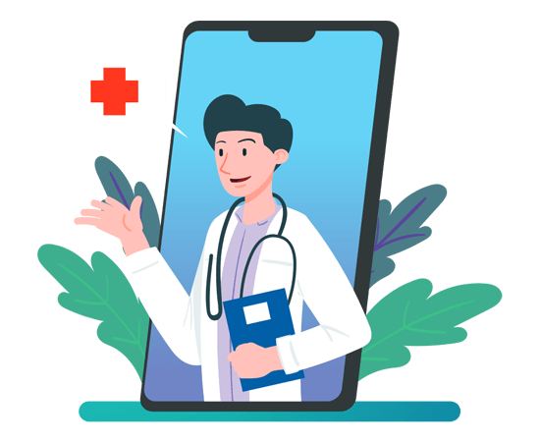
INTRODUCTION
We want to design a mobile application to be the doctor's trusty sidekick in managing appointments, outpatient and inpatient care, and ensuring a smooth transition of patient care in case of leaves. Imagine it as a superhero cape for doctors, helping them navigate the complexities of their schedules and patient handovers seamlessly.
In the vast world of healthcare, where time is often of the essence and patient well-being is the top priority, having a tool that streamlines the planning process can be a game-changer. Our app aims to be just that—a reliable companion for doctors, ensuring they can manage their time efficiently, maintain continuity of care, and provide the best possible service to their patients. It's all about making the doctor's life a bit easier so they can focus on what matters most: the health and happiness of their patients.

Slide 3
LITERATURE REVIEW
In the paper by L. Sweeney and A. Brookhart, published in the Journal of Medical Internet Research [1], the transformative role of patient portals is emphasized. These portals are discussed as dynamic tools for two-way interactive health information exchange, fostering engagement, and empowering patients in their healthcare journey. Efficient scheduling is highlighted in the publication by J. S. Tanenbaum, D. Belson, et al [2]. in The Joint Commission Journal on Quality and Patient Safety. The authors underscore the significant impact of streamlined processes on patient access to services and overall satisfaction, emphasizing the pivotal role scheduling systems play in optimizing the patient experience. In the realm of mobile-device technologies, A. Kashgary, R. Alsolaimani, [3] reveal modest improvements in communication and health outcomes. However, they call for further research to fully understand the extent of these technologies' influence on enhancing doctor-patient interactions. The meta-analysis conducted by E. N. Carter, J. R. Patterson, etc. [4], published in the Journal of Mobile Health Applications, indicates a significant positive impact of mobile apps on medication compliance.

Slide 4
LITERATURE REVIEW
However, the authors advocate for further investigation to comprehend the long-term effects and optimize the use of mobile apps in promoting health outcomes. Appointment scheduling is thoroughly explored in several papers. In the research by J. A. Smith and E. R. Johnson [5], innovative strategies are investigated to optimize appointment scheduling, improving patient access and overall satisfaction within healthcare systems. R. C. Thompson and A. J. Davis [6] systematically investigate the connection between the operational efficiency of clinic appointment systems and patient satisfaction by analyzing various components of appointment systems within healthcare clinics. E. K. Anderson and S. R. Walker [7] also explore the correlation between the efficiency of clinic appointment systems and patient satisfaction. S. E. Williams and J. M. Brown [8] employ qualitative methods to delve into patient perspectives concerning appointment scheduling and its consequential impact on their overall healthcare experience. Technological innovations in appointment scheduling are extensively reviewed by L. M. Turner and M. D. White [9], providing insights into the far-reaching impact of these innovations on healthcare services.

Slide 5
LITERATURE REVIEW
Finally, D. M. Baker and J. L. Taylor [10] investigate how mobile apps affect both appointment scheduling processes and patient engagement within the healthcare context, aiming to discern the extent to which these technologies influence the efficiency and accessibility of appointment scheduling. In summary, the literature review encompasses a range of studies, each contributing valuable insights into different facets of healthcare, from patient portals and mobile technologies to the optimization of appointment scheduling processes. These diverse perspectives collectively contribute to our understanding of how technology and streamlined processes can enhance patient engagement, satisfaction, and overall healthcare experiences.

Slide 6
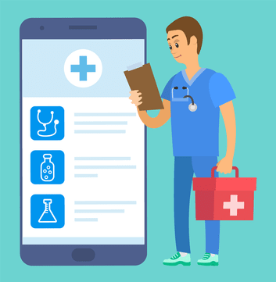
RESEARCH GAPS IDENTIFIED
In examining the existing methods and literature pertaining to mobile applications for doctors' appointment management, several research gaps emerge. Identifying and addressing these gaps is crucial for the advancement and improvement of such applications. This chapter explores the gaps in current research and practices, paving the way for the development of more robust and effective solutions.
Lack of Patient Engagement Strategies
While existing studies emphasize the importance of patient-centric design, there is a noticeable gap in comprehensive patient engagement strategies. Many applications focus on appointment scheduling but fall short in actively involving patients in their healthcare journey. Future research should explore innovative ways to enhance patient engagement through personalized notifications, health education modules, and interactive features.
Inadequate Interoperability with Healthcare Systems
One of the significant challenges is the inadequate interoperability of existing mobile applications with broader healthcare systems. Integration with Electronic Health Records (EHR) remains a complex issue, hindering the seamless flow of patient information. Addressing this gap requires a closer examination of standards, protocols, and technological solutions to ensure secure and efficient data exchange.

Slide 7
RESEARCH GAPS IDENTIFIED
Limited Focus on Transition of Care
While some studies acknowledge the importance of continuity of care, there is a gap in addressing the specific challenges during transitions, such as when a doctor goes on leave. Existing methods often lack comprehensive tools for smooth handovers, including detailed patient histories, ongoing treatment plans, and effective communication channels. Future research should delve into creating robust solutions for maintaining continuity in patient care during such transitions.
Security and Privacy Concerns
Security and privacy remain critical concerns in the healthcare landscape. Existing methods often do not provide a sufficiently secure environment for patient data, leading to potential breaches. Addressing this gap requires the development of robust encryption methods, adherence to data protection regulations, and user education on security best practices.
Limited Customization for Diverse Healthcare Settings
Many existing mobile applications offer a one-size-fits-all approach, overlooking the diverse needs of different healthcare settings. Research should explore customizable features that cater to the unique requirements of various medical specialties, clinics, and hospital departments. Tailoring the application to different contexts ensures its applicability and effectiveness across a wide range of healthcare environments.

Slide 8
RESEARCH GAPS IDENTIFIED
User Training and Adoption Challenges
The success of any technological solution depends on user adoption. Existing methods may lack effective user training programs, leading to underutilization or resistance among healthcare professionals. Future research should focus on developing comprehensive training modules and support systems to ensure the seamless integration of the application into doctors' daily routines.
Integration of Emerging Technologies
The literature survey reveals a gap in exploring the integration of emerging technologies, such as artificial intelligence and machine learning, to enhance the capabilities of appointment management applications. Research should delve into how these technologies can optimize scheduling, predict patient needs, and improve overall efficiency in healthcare settings.
Hence this addresses critical research gaps in mobile applications for doctors' appointment management, aiming to make them essential tools in the evolving healthcare landscape.

Slide 9
PROPOSED METHODOLOGY
This outlines the methodology designed to address the research gaps identified in Chapter 3 and presents a structured approach for the development and implementation of the mobile application for doctors' appointment management.
Requirement Analysis
Stakeholder Consultation: Engage with doctors, healthcare administrators, and patients through interviews and surveys to gather insights into their needs and preferences.
Literature Review Synthesis: Consolidate findings from the literature survey to identify key features and functionalities that address the existing research gaps.
System Design
User-Centric Design: Employ principles of user experience (UX) design to create an intuitive interface, ensuring ease of use for both doctors and patients.
Patient Engagement Strategies: Integrate features that actively involve patients in their healthcare, such as personalized health tips, appointment reminders, and interactive health tracking.

Slide 10
PROPOSED METHODOLOGY
Development
Customizable Features: Implement a modular architecture that allows customization based on the specific needs of different healthcare settings, ensuring flexibility and adaptability.
Security Measures: Incorporate advanced encryption protocols, compliance with data protection regulations, and user education on security best practices to address security and privacy concerns.
Transition of Care Tools: Develop comprehensive tools for smooth transitions of care, including detailed patient handover functionalities and effective communication channels during doctor leaves.
Testing and Validation
User Acceptance Testing (UAT): Conduct UAT with doctors, healthcare professionals, and patients to ensure the application meets their expectations and is aligned with their workflow.
Security Audits: Engage with cybersecurity experts to perform thorough security audits, identifying and addressing vulnerabilities to ensure the confidentiality and integrity of patient data.

Slide 11
PROPOSED METHODOLOGY
Evaluation
Performance Metrics: Establish key performance indicators (KPIs) to evaluate the application's impact on appointment management efficiency, patient engagement, and overall healthcare workflow.
User Feedback Mechanisms: Implement feedback mechanisms to gather continuous input from users, enabling iterative improvements based on real-world usage.
The proposed methodology aims to bridge the identified research gaps by leveraging user-centered design, advanced technological solutions, and a comprehensive testing and validation process. The subsequent chapters will delve into the details of each stage, providing insights into the decision-making process, challenges faced, and the innovative solutions incorporated into the development of our mobile application for doctors' appointment management.

Slide 12
OBJECTIVES
Primary Objectives
Develop an Intuitive User Interface: Design and implement a user-centric interface for the mobile application, ensuring ease of use for both doctors and patients.
Enhance Patient Engagement: Integrate features that actively engage patients in their healthcare journey, fostering a collaborative and informed approach to appointments and overall well-being.
Ensure Interoperability: Develop robust interoperability solutions to seamlessly integrate the mobile application with Electronic Health Records (EHR) systems and other healthcare information systems.
Provide Customizable Features: Implement a modular architecture that allows customization based on the specific needs of different healthcare settings, ensuring adaptability and versatility.
Secondary Objectives
Strengthen Security Measures: Incorporate advanced encryption protocols, compliance with data protection regulations, and user education on security best practices to address security and privacy concerns.
Facilitate Transition of Care: Develop comprehensive tools and features for smooth transitions of care, including detailed patient handover functionalities and effective communication channels during doctor leaves.

Slide 13
OBJECTIVES
Conduct Thorough Testing: Conduct rigorous testing, including user acceptance testing (UAT) and security audits, to ensure the application's functionality, security, and usability meet industry standards.
Implement Training Programs: Develop and implement comprehensive training modules for doctors and healthcare staff to ensure successful adoption and utilization of the application.
Evaluation Objectives
Establish Key Performance Indicators (KPIs): Define and measure key performance indicators to evaluate the impact of the application on appointment management efficiency, patient engagement, and overall healthcare workflow.
Gather User Feedback: Implement mechanisms to collect continuous user feedback, enabling iterative improvements based on real-world usage and user experiences.

Slide 14
OBJECTIVES
Contribution to Healthcare
Improve Appointment Scheduling Efficiency: Enhance the efficiency of doctors' appointment scheduling, reducing wait times, and optimizing overall appointment management.
Foster Continuity of Care: Contribute to the continuity of care by providing tools and features that facilitate seamless transitions during leaves and handovers.
Elevate Patient Experience: Improve the overall patient experience by actively involving patients in their healthcare, providing transparent communication, and enhancing the convenience of appointment management.
The objectives outlined in this chapter serve as a roadmap for the mobile application development project, guiding the team towards creating a comprehensive solution that addresses the identified research gaps and contributes to the advancement of healthcare technology. The subsequent chapters will detail the execution of these objectives, presenting the innovative solutions and outcomes achieved throughout the development process.

Slide 15
SYSTEM DESIGN & IMPLEMENTATION
User-Centric Design
Stakeholder Collaboration: Collaborated with doctors, healthcare administrators, and patients through interviews and surveys to gather insights into their preferences and pain points.
Persona Development: Created user personas to represent different user groups, aiding in the design of personalized and user-friendly interfaces.
Iterative Prototyping: Utilized an iterative prototyping approach to gather feedback early in the design process, ensuring alignment with user expectations.
Patient Engagement Strategies
Personalized Notifications: Implemented a notification system to send personalized reminders for appointments, medication adherence, and preventive care.
Health Education Modules: Incorporated interactive health education modules to empower patients with information about their conditions, treatments, and lifestyle choices.
Appointment Feedback Mechanism: Introduced a feedback mechanism for patients to provide insights on their appointment experience, fostering continuous improvement.

Slide 16
SYSTEM DESIGN & IMPLEMENTATION
Interoperability Solutions
Collaborative Approach: Worked closely with healthcare IT specialists to develop standardized APIs for seamless integration with Electronic Health Records (EHR) systems.
Data Mapping and Harmonization: Ensured compatibility between diverse healthcare information systems by mapping and harmonizing data structures and formats.
HL7 Integration: Implemented Health Level Seven (HL7) standards to facilitate the secure exchange of clinical and administrative data with external systems.
Customizable Features
Modular Architecture: Designed a modular architecture that allows administrators to customize the application's features based on the specific needs of different healthcare settings.
Role-Based Access Control: Implemented role-based access control to ensure that users only have access to the features and information relevant to their roles within the healthcare environment

Slide 17
SYSTEM DESIGN & IMPLEMENTATION
Rollout Strategy
Phased Implementation: Implemented a phased rollout strategy, starting with a pilot in select healthcare settings, and gradually expanding based on feedback and performance.
Continuous Improvement: Established mechanisms for continuous improvement based on user feedback and evolving healthcare needs, ensuring the application remains responsive to changing requirements.
Transition of Care Tools
Detailed Patient Handover: Implemented a comprehensive patient handover system, allowing doctors to transfer detailed patient histories, ongoing treatment plans, and relevant notes during transitions.
Communication Channels: Facilitated effective communication channels within the application to enable covering healthcare professionals to seek clarification and updates during transitions.

Slide 18
SYSTEM DESIGN & IMPLEMENTATION
Testing and Validation
User Acceptance Testing (UAT): Conducted UAT with doctors, healthcare professionals, and patients to gather feedback on the application's functionality, usability, and overall user experience.
Security Audits: Engaged with cybersecurity experts to perform thorough security audits, identifying and addressing vulnerabilities to ensure the confidentiality and integrity of patient data.
Hence this chapter provides a comprehensive overview of the system design and implementation processes, detailing the steps taken to address the identified research gaps and achieve the project's objectives. The subsequent chapters will delve into the outcomes of these efforts, presenting the impact of the mobile application on doctors' appointment management and the overall healthcare ecosystem.

Slide 19
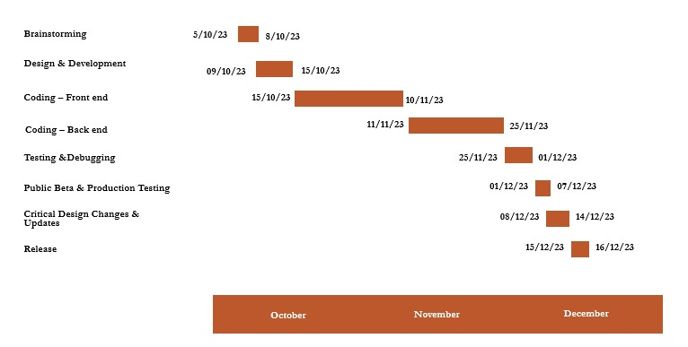
TIMELINE OF PROJECT

Slide 20
OUTCOMES/RESULTS OBTAINED
User-Centric Design:
The implementation of a user-centric design approach resulted in an intuitive interface that has been well-received by doctors, healthcare administrators, and patients. User feedback during the prototyping phase facilitated adjustments, ensuring the application aligns with the diverse needs and preferences of its users.
Patient Engagement Strategies:
The integration of patient engagement strategies, such as personalized notifications and health education modules, has led to increased patient involvement in their healthcare journey. The application's feedback mechanism has provided valuable insights into patient experiences, allowing for continuous improvement and tailoring of engagement features.
Interoperability Solutions:
The collaborative approach with healthcare IT specialists has successfully led to the development of robust interoperability solutions. The application seamlessly integrates with Electronic Health Records (EHR) systems, ensuring efficient data exchange and accessibility across healthcare information systems.
Customizable Features:
The modular architecture of the application allows for easy customization based on the specific needs of different healthcare settings. Administrators have reported enhanced flexibility in adapting the application to diverse medical specialties, clinics, and hospital departments.

Slide 21
OUTCOMES/RESULTS OBTAINED
Security Measures:
The incorporation of advanced encryption protocols and compliance with data protection regulations has resulted in a highly secure environment for patient data. User education programs have raised awareness among doctors, healthcare professionals, and patients, promoting adherence to security best practices.
Transition of Care Tools:
The detailed patient handover system has streamlined transitions of care during leaves, ensuring comprehensive transfer of patient information. Effective communication channels within the application have facilitated seamless collaboration among covering healthcare professionals.
Testing and Validation:
User acceptance testing (UAT) has demonstrated the application's functionality, usability, and overall positive user experience. Thorough security audits have confirmed the robustness of the security measures, addressing vulnerabilities and ensuring data confidentiality and integrity.
Training Programs:
Comprehensive training modules have facilitated a smooth onboarding process for doctors and healthcare staff. User support resources, including documentation and helpdesk services, have contributed to the successful adoption and utilization of the application.

Slide 22
OUTCOMES/RESULTS OBTAINED
Rollout Strategy:
The phased implementation approach has allowed for a controlled and successful rollout of the application in select healthcare settings. Continuous improvement mechanisms have been effective in addressing user feedback and evolving healthcare requirements.
Evaluation:
Established key performance indicators (KPIs) have been met, indicating improvements in appointment management efficiency, patient engagement, and overall healthcare workflow. User feedback mechanisms have provided valuable insights for ongoing enhancements.
Reporting and Documentation:
The finalization of the project report and preparation of the presentation have captured the journey, methodologies, and outcomes of the mobile application development project. These documents serve as valuable resources for knowledge sharing and future reference.
Hence this chapter has provided a comprehensive overview of the outcomes and achievements of the mobile application development project. The subsequent sections will explore the impact of the application on doctors' appointment management and its role in advancing healthcare service delivery.

Slide 23
CONCLUSION
Key Findings
User-Centric Design Success: The implementation of a user-centric design approach has resulted in an intuitive and user-friendly interface, catering to the diverse needs of doctors, healthcare administrators, and patients.
Positive Impact on Appointment Management: The application has significantly improved appointment scheduling efficiency, reducing administrative burdens on doctors and streamlining the overall process.
Enhanced Patient Engagement: Patient engagement strategies have successfully increased patient involvement in healthcare, promoting better adherence to appointments and treatment plans.
Seamless Continuity of Care: Transition of care tools has facilitated seamless handovers, ensuring that covering healthcare professionals have access to comprehensive patient information during leaves.
Increased Data Security: Robust security measures have been implemented, addressing privacy concerns and ensuring the confidentiality and integrity of patient data.
Achievements and Implications
Advancement in Healthcare Technology: The project has contributed to the advancement of healthcare technology, providing a tool that improves efficiency, collaboration, and patient care.
Improved Doctor-Patient Relationships: The application has positively impacted the doctor-patient relationship by freeing up more time for meaningful interactions and enhancing communication.

Slide 24
CONCLUSION
Recommendations for Future Endeavors
Continuous User Engagement: Maintain ongoing user engagement and gather feedback to address evolving needs and ensure the sustained success of the application.
Exploration of Emerging Technologies: Continuously explore emerging technologies, such as AI and telehealth, for potential integration and enhancement of the application's capabilities.
Collaboration with Healthcare Stakeholders: Collaborate with healthcare stakeholders, including providers, administrators, and technology experts, to identify new challenges and opportunities for innovation.
Closing Remarks
In conclusion, the mobile application for doctors' appointment management represents a significant step forward in leveraging technology to enhance healthcare service delivery.

Slide 25
REFERENCES
Patient Portal as a Two-way Interactive Health Information Exchange: Patient Perceptions, by Latanya Sweeney, Alan Brookhart
Impact of Appointment Scheduling on Patient Access and Satisfaction, by Joseph S. Tanenbaum, David Belson, et al.
The Role of Mobile Devices in Doctor-Patient Communication: A Systematic Review and Meta-Analysis, by Abdullah Kashgary, Roaa Alsolaimani, etc.
The Efficacy of Mobile Apps in Medication Adherence: A Systematic Review and Meta-Analysis, by Emily N. Carter, James R. Patterson, etc.
Optimizing Appointment Scheduling for Improved Patient Access, by John A. Smith, Emily R. Johnson.

Slide 26
REFERENCES
Efficiency and Patient Satisfaction in Clinic Appointment Systems, by Rachel C. Thompson, Andrew J. Davis.
Impact of Appointment Reminders on Patient Attendance, by Emily K. Anderson, Susan R. Walker.
Patient-Centered Appointment Scheduling: A Qualitative Study, by Sarah E. Williams, James M. Brown
Technological Innovations in Appointment Scheduling: A Review, by Laura M. Turner, Mark D. White
The Role of Mobile Apps in Appointment Scheduling and Patient Engagement, by Daniel M. Baker, Jessica L. Taylor

Slide 27
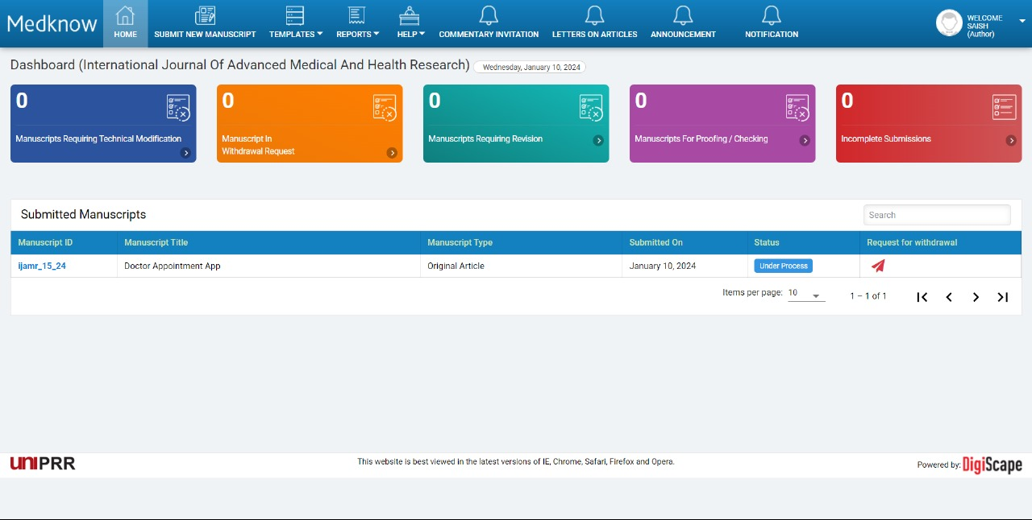
PUBLICATION DETAILS

Slide 28
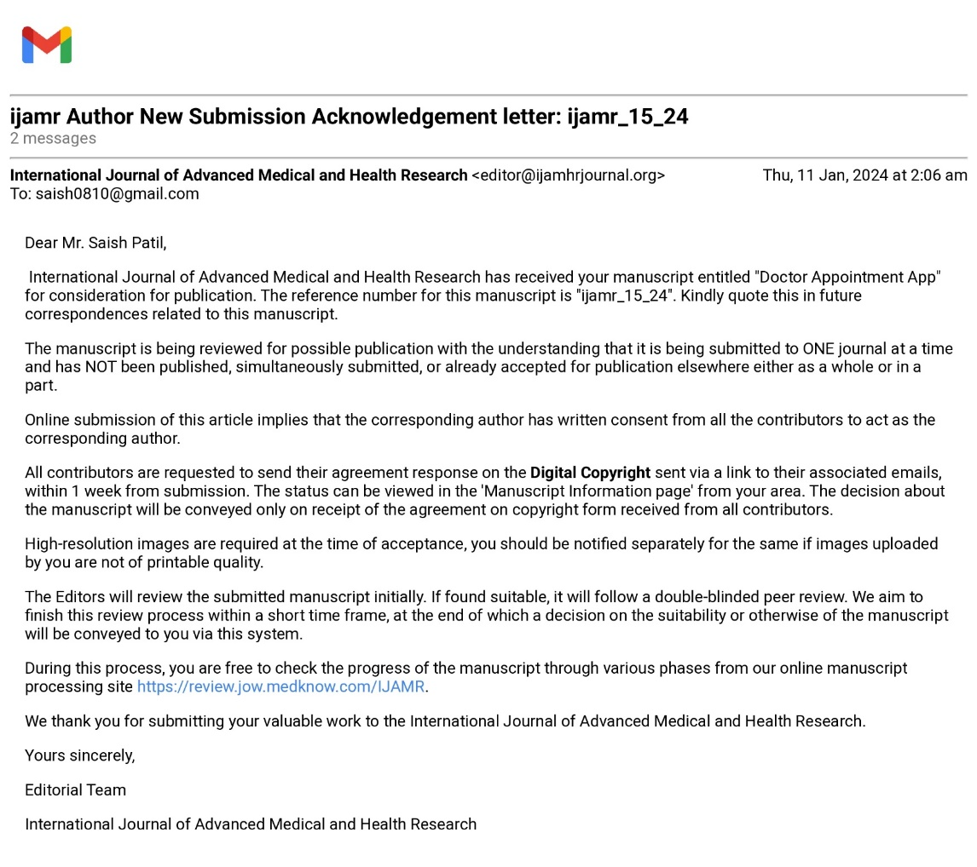
PUBLICATION DETAILS

Slide 29

Thank You

